Slide 1


PRELIMINARY QUALITATIVE STUDY ON AI AND BURNOUT:
diagnostic potential of vocal biomarkers
Chiara Bassi¹, Akylai Anarbaeva², Francesca Marinaro¹², Andrea Buccoliero¹², Anna Maria Meneghini¹, Riccardo Sartori¹, Andrea Ceschi¹
¹ University of Verona, Department of Human Sciences, Verona, Italy
² GPI Group, Research & Development, Trento, Italy

Slide 2
Challenges in Validating Biomarkers for Burnout Diagnosis
Although several studies have investigated physiological correlates of burnout, research on biological markers is still considered underdeveloped and inconclusive.
Lack of Conceptual Clarity
  No shared definition of burnout → different studies may measure different phenomena
Poor Diagnostic Grounding
  Most studies rely on tools like MBI, which lack standardized diagnostic thresholds
Methodological Limits
  Most research is cross-sectional, not longitudinal → hard to establish causal links
Heinemann & Heinemann, (2017); Nadon, et al., (2022); Parker & Tavella,(2022)
Applied Research in Society and Organizations
Notes:
The sources discuss the investigation into biomarkers related to burnout, which falls under the category of studies focusing on the physiological processes underlying the syndrome1. These studies aim to identify biological markers to potentially improve diagnosis and treatment1. Examples mentioned include autonomic nervous system activation, changes in cortisol levels, immune functions, endocrine functions2, metabolic processes3, and brain activity1.
•
However, the research on these correlates is considered "underdeveloped"2. Only a "very small number of studies"4 endeavor to identify biomarkers that could help define or diagnose burnout4.
•
The sources state that it is difficult to draw any "firm conclusions" from the existing research on biomarkers2....
•
The reasons for this difficulty and why biomarkers are not currently used for formal diagnosis are primarily tied to the fundamental challenges in burnout research itself:
◦
There is a lack of conceptual clarity and consensus on the definition and measurement of burnout2.... This means researchers might be studying different phenomena, even when looking for biological correlates5....
◦
Studies attempting to identify biomarkers often rely on classifying participants as having burnout using existing questionnaires (like the MBI)1.... However, these questionnaires have limitations, and there's no consensus on cut-off points for diagnosis7.... This makes it challenging to clearly identify homogeneous "burnout patients"5 distinct from healthy individuals or those with other conditions like depression5.
◦
There is variability in results across different populations and studies2.
◦
Most studies are predominantly cross-sectional2, while longitudinal studies would be necessary to determine biomarkers that could differentiate burnout from other well-established mental disorders2....
◦
Some studies show potential distinctions in biological changes compared to depression, while others show overlap in markers10. Biomarkers are not yet able to reliably differentiate burnout from depression2....
•
The lack of solid research on biomarkers is considered an "important obstacle" to positioning burnout as a distinct diagnostic category within medically inspired classification systems like DSM or ICD2....
•
In summary, while the study of biomarkers is happening, according to the sources, it is still in its early stages, findings are inconclusive, and biomarkers are not used as diagnostic tools because the foundational conceptual and measurement issues regarding burnout itself prevent drawing clear conclusions from this biological resea

Slide 3
What do we know about biomarkers in burnout?
Authors (year) | Biomarker class | Validated? | Validation method
Danhof-Pont et al.2011 Grossi et al., (2015) Khamissa et al. (2022) | HPA axis | yes | MBI, KEDS; SMBQ
Grossi et al., (2015) | Autonomic nervours system (ANS) | yes | MBI, KEDS
Danhof-Pont et al.2011 | Cardiovascular | yes | MBI,SMBQ
Danhof-Pont et al.2011 | Metabolic | yes | MBI,SMBQ
Danhof-Pont et al.2011 | Immune system | yes | MBI,SMBQ
Danhof-Pont et al.2011 | Hormonal (non cortisol) | yes | MBI,SMBQ
Danhof-Pont et al.2011 | Antioxidants | yes | MBI,SMBQ
MBI = Maslach Burnout Inventory; KEDS = Karolinska Exhaustion Disorder Scale; SMBQ = Shirom-Melamed Burnout Questionnaire
Applied Research in Society and Organizations
Notes:
In our review of the literature, several classes of physiological biomarkers have been validated through psychometric scales in association with burnout. Specifically, cortisol—both in its salivary and serum forms—has been one of the most consistently studied markers. Grossi et al. (2015) validated salivary and serum cortisol using three well-established scales: the Maslach Burnout Inventory (MBI), the Karolinska Exhaustion Disorder Scale (KEDS), and the Shirom-Melamed Burnout Questionnaire (SMBQ). Similarly, Khammissa et al. (2022) confirmed the association of serum cortisol with burnout levels using the MBI.
Neurophysiological markers such as EEG patterns, particularly in alpha and beta frequencies, were also validated by Grossi et al. through MBI and KEDS scores. This highlights the role of brain activity alterations in stress-related exhaustion disorders.
Heart Rate Variability (HRV), a common indicator of autonomic nervous system balance, was another key class validated in Grossi et al.'s work, again using both the MBI and KEDS to establish convergent validity.
Lastly, inflammatory markers like interleukin-6 (IL-6) and tumor necrosis factor-alpha (TNF-alpha) were examined by Khammissa et al. (2022) and found to be significantly associated with MBI scores, suggesting that systemic inflammation may play a role in the pathophysiology of burnout.
These findings collectively strengthen the case for integrating biological measures with psychometric tools in both research and clinical diagnostics of burnout.

Slide 4
From uncertainty to inquiry: why we interviewed experts
No vocal biomarkers have yet been used in burnout assessment.
There is growing interest and several examples of objective AI-based tools (e.g., machine learning and deep learning) applied to burnout detection (Grządzielewska, 2021).
Automated (AI-based) speech recognition has been used for various mental disorders (Low et al., 2020), and more recently, for detecting strain related to work stressors (Langer et al., 2022).
Technological Opportunity
AI can detect vocal patterns
Expert Inquiry
We interviewed clinicians, psychologists, and researchers
Vocal biomarkers need theoretical grounding
To understand how burnout is assessed
And to explore the diagnostic potential of voice and emotion trough AI based tools
Applied Research in Society and Organizations
Notes:
So staring from the gap in literature and from the new and big spaces we develop our sudy in particolar to undesrstand ai in detenction of vocal patterns , and the needs of vocal biomarker to be grounded in a theoretical framework. So due to the new of this topi we Expert Inquiry
We interviewed clinicians, psychologists, and researchers
To understand how burnout is assessed
And to explore the diagnostic potential of voice and emotion trough AI based tools
So we tought to

Slide 5
Research questions and objectives
Which assessment tools are currently used for diagnosing and monitoring burnout, and what clinical data do they provide?
Understand how burnout is currently assessed in practice
Which vocal features can be identified as potential biomarkers for burnout, and what other clinical elements support them?
Explore the potential role of voice and emotion in early detection
Which tools are most effective for early and accurate detection, and what are the limitations of current methods?
Identify perceived limitations of existing tools and opportunities for innovation
Applied Research in Society and Organizations
Notes:
Relted to what I just fiished to say we develop tre mai research and associated objecitves that guides the developmentf of the interview. The question relatd to "hich assessment tools are currently used for diagnosing and monitoring burnout, and what clinical data do they provide?" Then "Which vocal features can be identified as potential biomarkers for burnout, and what other clinical elements support them?
" "Which tools are most effective for early and accurate detection, and what are the limitations of current methods?
" Trying to map the key oint of our aims.

Slide 6
Study design and method
How?
Semi-structured interviews based on Dejonckheere & Vaughn (2019)
10 questions aligned with overarching research questions
Qualitative, bottom-up approach
Conducted online via Zoom from May 2024 to September 2024 (four months)
Ethics & Consent
Audio-recorded interviews
Ethical approval granted
Informed consent obtained
Saturation at 20 participants Guest et al. (2006)
Applied Research in Society and Organizations
Notes:
To reply and reach ur objectives, we conducted semi structured interview according to the guidelinesy Dejonckheere & Vaughn (2019) used in health services research. In totla we developed a 10 question starting from the research question peviously defined, and we develop the questions in order to analyzed the question following a qualitative bottom-up approach. Staring form the ishgt of specialist.
So we conducted the intevierw trhogh digital platform, with the aim to enlarge our sample and at the same time to audio-video recordes the inteview. The infomed cosent was sent before the interview and all the participants send back though email the consent signed. The selection of the number of participants is guided by the specificity of the research objectives and the characteristics of the target sample, selecting participants based on their specialist expertise pertinent to the interview objective. The number of interviewees may vary based on the concept of data saturation, which indicates the point at which new information produces little or no change in the analysis code. The adopted methodology follows the guidelines of Guest et al. (2006), whereby the level of information saturation is monitored through the progression of theme identification, that is, the structure of the analysis code after each series of six interviews, for a total of three analysis cycles. After coding the first six interviews, a cumulative audit trail will be created with registry updates after the analysis of each series of six transcripts. Therefore, in the first analysis phase, the first six transcripts will be examined, followed by the addition of another six in the second phase, for a total of twelve, and so on. The number of interviewees may be lower than the initially planned 20 depending on the saturation of the analyzed information.

Slide 7
Study design and participants
Who?
Medical doctors and psychotherapists [MED/PSI]
Residents and PhD students [SPEC/DOT]
Researchers and professors [RIC/PROF]
Other professionals [OTHER]
How many?
20 participants in total
7 [SPEC/DOT]
7 [RIC/PROF]
6 [MED/PSI]
Applied Research in Society and Organizations
Notes:
We individuated 4 different categories of professionals allowing us to gain insight about how usualy burnout Is assesed , the tools and the isght related to the possible link on voice and emotions and burnout. Than at the end pf the data collection phase, we reached 20 parcipants in total trogh which 7 specilization and phd student and study and specilizes in this field, 7 university professor and reserher nera always specialized in this and 6 psychoterapist with a big experience in the assessment of helath psychology in partilura relted to burnout syndrome.

Slide 8
Analysis plan: Quantitative semantic analysis
Word Embedding Analysis
Transcripts were processed using natural language processing (NLP) techniques
Word embeddings allowed the extraction of frequently co-occurring semantic patterns
Python and several libraries were used:
• docx2txt: text extraction from transcripts
• stop-words: filtering of common Italian words
• scikit-learn: keyword frequency detection
• matplotlib, wordcloud: data visualization (word clouds)
• seaborn: plotting most frequent bigrams
This approach provided a visual representation of semantic usage across experts
Applied Research in Society and Organizations
Notes:
1. interviews were read so as to eliminate any transcription errors
2. the content of the interviews was extracted from the documents so as to allow processing
3. stop words were eliminated (stop words means all words that do not add meaning to the text, so conjunctions, adverbs, articles, etc...)
4. key words were identified, i.e., those present in greater quantity within the interviews
5. key words were represented as word clouds; this type of representation allows words to be visualized in different sizes according to the number of occurrences
6. in addition, histograms (bi-grams) representing the most frequent word pairs were plotted
Le interviste sono state analizzate applicando algoritmi di NLP (Natural Language Processing) con l'obiettivo di estrarre informazioni utili dal testo, in particolare individuando le parole chiave (intese come le parole più frequenti nel testo) e le coppie di parole consecutive con maggiore occorrenza.
Con l'acronimo NLP si indica un campo dell’intelligenza artificiale che si occupa dell’interazione tra computer e linguaggio umano, con l’obiettivo di permettere alle macchine di comprendere, interpretare, generare e rispondere al linguaggio umano in modo utile e significativo.
Nel nostro caso, si applicano algoritmi di NLP con l'obiettivo di estrarre informazioni e conoscenza dal testo, rappresentandole sotto forma di grafici.
Le interviste sono state lette al fine di eliminare eventuali errori di trascrizione.
Attraverso la libreria docx2txt, il contenuto delle interviste è stato estratto e inserito in un array.
Successivamente, sono state individuate le stop words. Con questo termine si fa riferimento a tutte le parole che non aggiungono significato al contesto analizzato, quali: articoli, preposizioni, congiunzioni; per tale motivo possono essere eliminate dal corpus di dati analizzati.
È stata utilizzata la libreria Python stop_words, che fornisce una lista delle stop words più comuni in diverse lingue.
Inoltre, sono stati eliminati i caratteri speciali, i numeri, e tutte le parole sono state convertite in minuscolo.
La lista di parole estratte può essere rappresentata sotto forma di word cloud. Le word cloud sono utili per visualizzare le parole comuni in un testo o in un dataset, e servono principalmente a offrire una panoramica ad alto livello dei temi principali.
La dimensione delle parole dipende dalla frequenza con cui compaiono (cioè dalla loro importanza nel contesto), ed è per questo che risultano molto utili nei progetti di machine learning basati sull’elaborazione del linguaggio naturale o nell’analisi del testo.
È stata utilizzata la libreria Python wordcloud, che mette a disposizione diverse funzioni, tra cui generate(), che ha permesso di creare word cloud a partire da una stringa di testo.
Infine, sono stati tracciati dei bigrammi, vale a dire delle coppie di parole consecutive, rappresentate graficamente in funzione della loro frequenza.
Per l’estrazione dei bigrammi si è utilizzata la funzione CountVectorizer della libreria Python scikit-learn. Questa funzione consente di convertire il testo in una rappresentazione numerica, dove ogni colonna rappresenta un bigramma e ciascun valore corrisponde alla sua frequenza nel corpus.
I bigrammi vengono poi ordinati in base alla frequenza decrescente e viene selezionato un numero definito di occorrenze più significative (in questo caso, i primi 20).
I dati ottenuti vengono organizzati in un DataFrame tramite la libreria Python pandas, con due colonne:
Bi-gram: la coppia di parole
Freq: la frequenza assoluta di occorrenza nel corpus
Questa tabella costituisce la base per la visualizzazione grafica successiva.
La fase finale prevede la visualizzazione dei bigrammi più frequenti attraverso un grafico a barre, realizzato con la libreria seaborn. L’asse delle ascisse rappresenta i bigrammi, mentre l’asse delle ordinate ne indica la frequenza. Il grafico permette di cogliere visivamente le combinazioni di parole più rilevanti all’interno del corpus, fornendo un valido supporto interpretativo.

Slide 9






Analysis plan: Qualitative thematic analysis
Thematic analysis (Clarke & Braun, 2017)
Audio-recorded and transcribed verbatim
Conducted independently by three researchers
Bottom-up approach
Based on Braun & Clarke’s six-phase framework:
Codes, sub-theme and themes were refined through discussion and convergence
Multiple meetings were organized to collaboratively resolve coding inconsistencies and ensure alignment across coders
  Familiarization with the data
  Generating initial codes
  Searching for themes
  Reviewing themes
  Defining and naming themes
  Producing the report
Applied Research in Society and Organizations
Notes:
Audio-recorded and transcribed verbatim
Conducted independently by three researchers
Bottom-up approach
Based on Braun & Clarke’s six-phase framework:
Codes, sub-theme and themes were refined through discussion and convergence
Multiple meetings were organized to collaboratively resolve coding inconsistencies and ensure alignment across coders
According to Clarke and Braun (2017), thematic analysis (TA) unfolds through six structured phases, each serving a distinct analytical purpose within the qualitative research process. Here's a concise explanation in English of each phase and what it entails:
Familiarization with the data
The researcher immerses themselves in the data by reading and re-reading it, taking initial notes. This phase is foundational, as it allows a deep understanding of the content and begins the process of identifying potential patterns.
Generating initial codes
The researcher systematically identifies and labels features of the data that appear interesting or relevant. These codes are the basic units of meaning and are used to organize the data into meaningful groups.
Searching for themes
In this phase, the researcher groups codes into potential themes. A theme represents a broader pattern of meaning that captures something important about the data in relation to the research question.
Reviewing themes
This involves checking how well the themes work in relation to the coded extracts and the entire data set. Themes are refined, split, combined, or discarded to ensure coherence and distinctiveness.
Defining and naming themes
The researcher conducts a deeper analysis of each theme, defining what each theme is about, what it includes and excludes, and identifying a concise and informative name for each one.
Producing the report
The final phase involves weaving together the analytic narrative and data extracts to tell a compelling story that answers the research question. This includes finalizing the write-up with attention to clarity, coherence, and theoretical contribution.

Slide 10
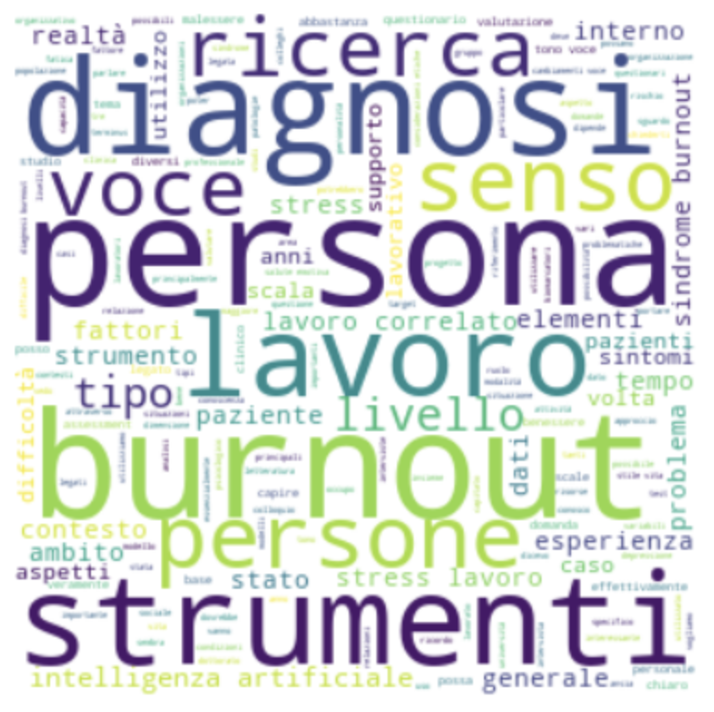
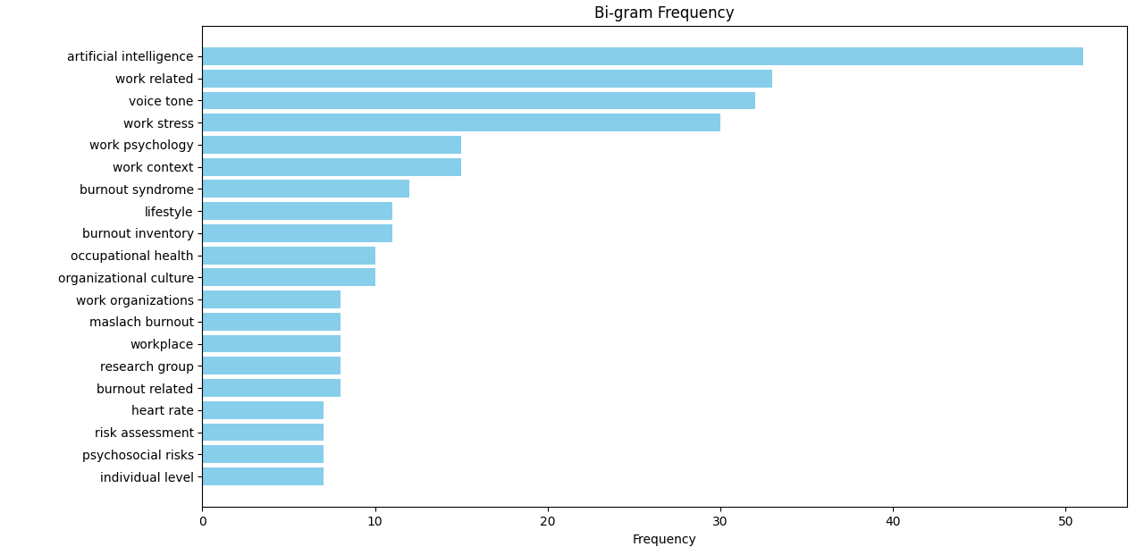
Results: Word Embedding Analysis
Words cloud
Histogram of the most frequent word pairs (bigrams)
Applied Research in Society and Organizations
Notes:
Come primo risulato vediamo quali sono state le parole maggiormet utilizzate dai nostri intervistatori anche pem proxy er farci un'idea di che cosa troveremo a livello qualitativo. e sono bunrout , la persona come centro di studio e di sviluppo dle nuovo e poi gli trumenti fondamentli per l'assemnet , il lavoro come fulcro da cui partire e modificare tali strumenti voce, senso ricerca

Slide 11
Results: Thematic analysis
Theme 1: Challenges and gaps in current burnout assessment tools
Sub-theme 1.1: Lack of Accuracy
Sub-theme 1.2: Multilevel and Systemic Assessment Needs
Theme 2: Physiological and Vocal Biomarkers in Burnout Detection
Sub-theme 2.1: Physiological Indicators Mirroring Chronic Stress
Sub-theme 2.2: Vocal Markers Reflecting Emotional and Cognitive States
Theme 3: Multimodal Behavioral and Contextual Factors in Burnout Assessment
Sub-theme 3.2: Emotional Content of Language
Sub-theme 2.3: Eye-Tracking and Cognitive Load Indicators
Sub-theme 3.1: Non-Verbal Communication Patterns
Sub-theme 3.3: Indicators of Cognitive Load and Monitoring Tools
Sub-theme 1.3: Innovative Diagnostic Approaches
Sub-theme 1.4: Clinical and Psychophysiological Evaluation
Sub-theme 1.5: Monitoring Before and After Onset
Applied Research in Society and Organizations

Slide 12
Results: Thematic analysis
Theme 4: Multilevel Barriers to the assessment of Burnout
Sub-theme 4.2: Cognitive and Awareness Gaps
Sub-theme 4.3: Structural Limitations of the Healthcare System
Theme 5: Organizational and Legal Responsibility in Burnout Assessment
Sub-theme 5.1: Accountability of Organizational Systems
Sub-theme 5.2: Legal Mandates for Psychosocial Risk Evaluation
Sub-theme 4.4: Burnout's Position in Clinical Practice
Sub-theme 4.5: Medical System's Role and Responsibility
Sub-theme 5.3: Financial Implications of Wearable Technology
Theme 6: AI in Burnout Assessment: Challenges, Applications, and Risks
Sub-theme 6.1: AI Utility in Voice Analysis and Multimodal Integration
Sub-theme 6.2: Ethical Considerations in AI Deployment
Sub-theme 6.3: Practical consideration of AI in Clinical Practice
Applied Research in Society and Organizations
Notes:
Theme 4: Multilevel Barriers to the assessment of Burnout
Sub-theme 4.1: Economic Constraints
Code → Underestimation of burnout due to financial and structural limitations
Sub-theme 4.2: Cognitive and Awareness Gaps
Code → Lack of symptom recognition and burnout literacy
Sub-theme 4.3: Structural Limitations of the Healthcare System
Code → Limited availability and accessibility of general practitioners
Code → Insufficient time allocated for thorough diagnosis
Sub-theme 4.4: Cultural and Social Norms
Code → Cultural valorization of self-sacrifice and overwork
Code → Reluctance to disclose psychological distress
Sub-theme 4.5: Burnout's Position in Clinical Practice
Code → Neglect of burnout assessment in psychiatric and psychological evaluations
Code → Insufficient recognition of burnout as a legitimate medical concern
Sub-theme 4.6: Medical System's Role and Responsibility
Code → Central role of occupational physicians in diagnosis
Code → Lack of interdisciplinary dialogue on differential diagnosis
Code → Insufficient medical training on work-related psychological conditions
Code → Fragmentation of responsibilities between clinical and occupational health fields

Slide 13
Conclusions: What to improve & what we learned
Limits of the study:
Self-selected sample
Possible interviewer bias
Themes not exclusive
Limited sample size
Advancing burnout assessment theory: ​
By highlighting the need for multi-dimensional and data-driven assessment tools, this study contributes to expanding current theoretical frameworks especially around how burnout is assessed (Nadon et al., 2022; Grossi et al., 2015). ​
Promoting objective, quantifiable metrics based on the AI tools and biomarkers: ​
By advocating the use of the AI-based assessments on physiological biomarkers – such as vocal biomarkers to derive vocal patterns and emotional clues - the study advocates for rigorous burnout assessment (Grządzielewska, M. 2021).​
Applied Research in Society and Organizations
Notes:
Limits : Self-selected sample
Possible interviewer bias
Themes not exclusive
Limited sample size.
And what we leanred form this study :Advancing burnout assessment theory:
By highlighting the need for multi-dimensional and data-driven assessment tools, this study contributes to expanding current theoretical frameworks especially around how burnout is assessed (Nadon et al., 2022; Grossi et al., 2015).
Promoting objective, quantifiable metrics based on the AI tools and biomarkers:
By advocating the use of the AI-based assessments on physiological biomarkers – such as vocal biomarkers to derive vocal patterns and emotional clues - the study advocates for rigorous burnout assessment (Grządzielewska, M. 2021).

Slide 14
References
Clarke, V., & Braun, V. (2017). Thematic analysis. The Journal of Positive Psychology, 12(3), 297–298. https://doi.org/10.1080/17439760.2016.1262613
Danhof-Pont, M. B., van Veen, T., & Zitman, F. G. (2011). Biomarkers in burnout: A systematic review. Journal of Psychosomatic Research, 70(6), 505–524. https://doi.org/10.1016/j.jpsychores.2010.10.012
Dejonckheere, M., & Vaughn, L. M. (2019). Semistructured interviewing in primary care research: A balance of relationship and rigour. Family Medicine and Community Health, 7, e000057. https://doi.org/10.1136/fmch-2018-000057
Grossi, G., Perski, A., Osika, W., & Savic, I. (2015). Stress-related exhaustion disorder – Clinical manifestation of burnout? Scandinavian Journal of Psychology, 56(6), 626–636. https://doi.org/10.1111/sjop.12251
Grządzielewska, M. (2021). Using machine learning in burnout prediction: A survey. Child and Adolescent Social Work Journal, 38(2), 175–180. https://doi.org/10.1007/s10560-020-00695-0
Guest, G., Bunce, A., & Johnson, L. (2006). How many interviews are enough? An experiment with data saturation and variability. Field Methods, 18(1), 59–82. https://doi.org/10.1177/1525822X05279903
Heinemann, L. V., & Heinemann, T. (2017). Burnout research: Emergence and scientific investigation of a contested diagnosis. SAGE Open, 7(1), 2158244017697154. https://doi.org/10.1177/2158244017697154
Khammissa, R. A. G., Fourie, J., & Lemmer, J. (2022). Burnout phenomenon: Neurophysiological factors, clinical features, and aspects of management. Journal of Psychology and Psychotherapy, 12(1), 1–6. https://doi.org/10.35248/2161-0487.22.12.456
Langer, M., König, C. J., Siegel, R., Fredenhagen, T., Schunck, A. G., Hähne, V., & Baur, T. (2022). Vocal-stress diary: A longitudinal investigation of the association of everyday work stressors and human voice features. Psychological Science, 33(7), 1027–1039. https://doi.org/10.1177/09567976221088347
Low, D. M., Bentley, K. H., & Ghosh, S. S. (2020). Automated assessment of psychiatric disorders using speech: A systematic review. Laryngoscope Investigative Otolaryngology, 5(1), 96–116. https://doi.org/10.1002/lio2.354
Nadon, L., De Beer, L. T., & Morin, A. J. S. (2022). Should burnout be conceptualized as a mental disorder? Behavioral Sciences, 12(3), 82. https://doi.org/10.3390/bs12030082
Parker, G., & Tavella, G. (2022). The diagnosis of burnout: Some challenges. The Journal of Nervous and Mental Disease, 210(7), 475–478. https://doi.org/10.1097/NMD.000000000000146
Applied Research in Society and Organizations

Slide 15
THANK YOU FOR YOUR ATTENTION
Chiara.bassi@univr.it

