Slide 1




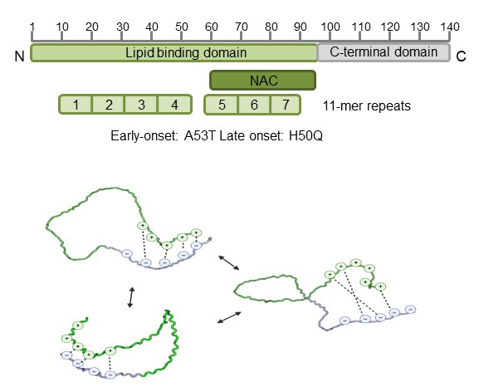
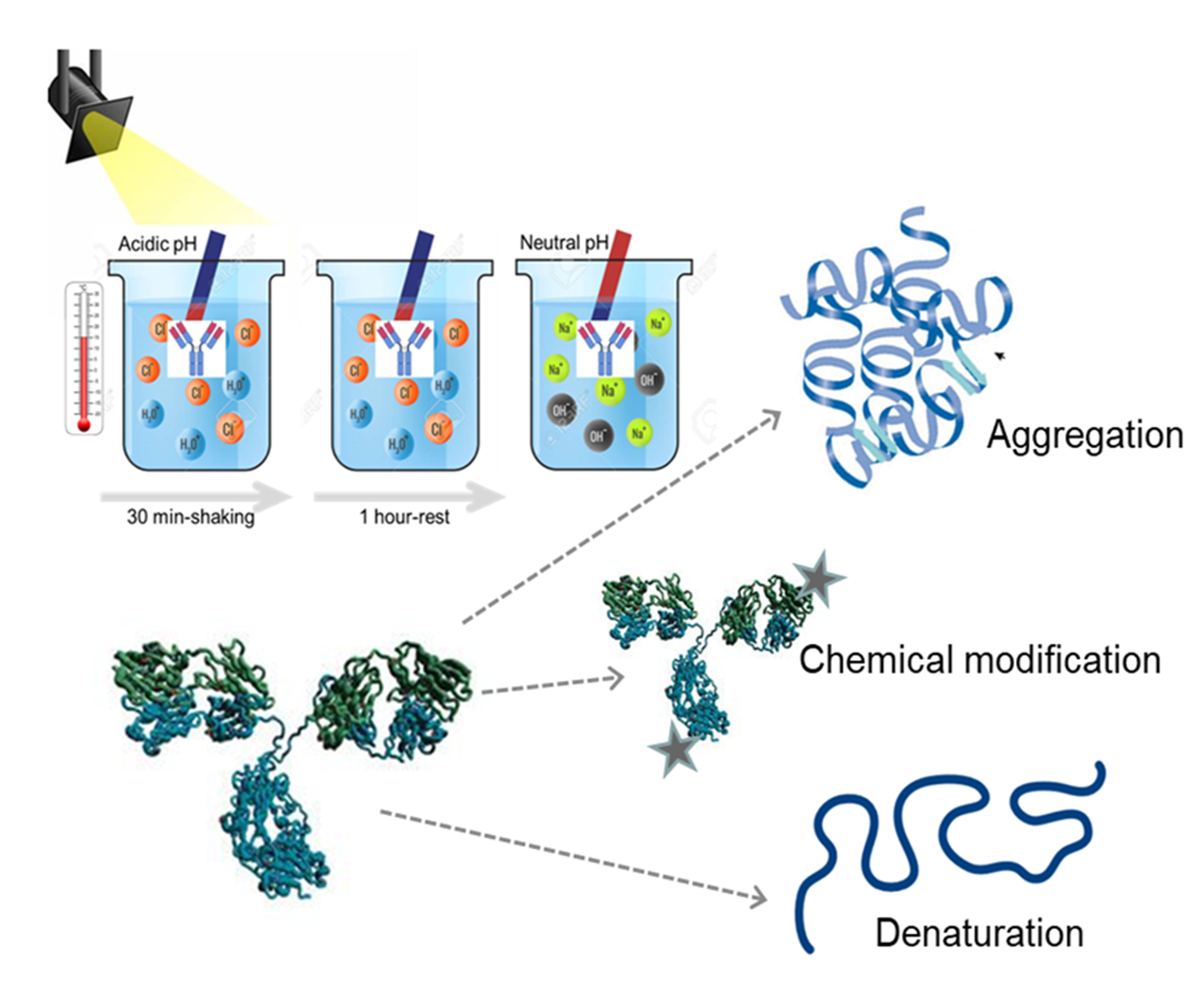


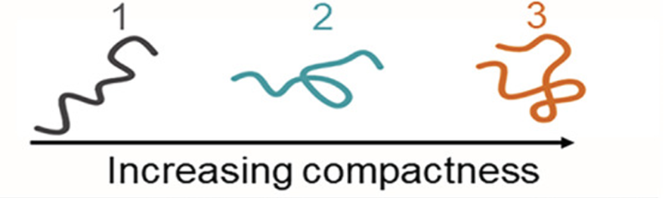
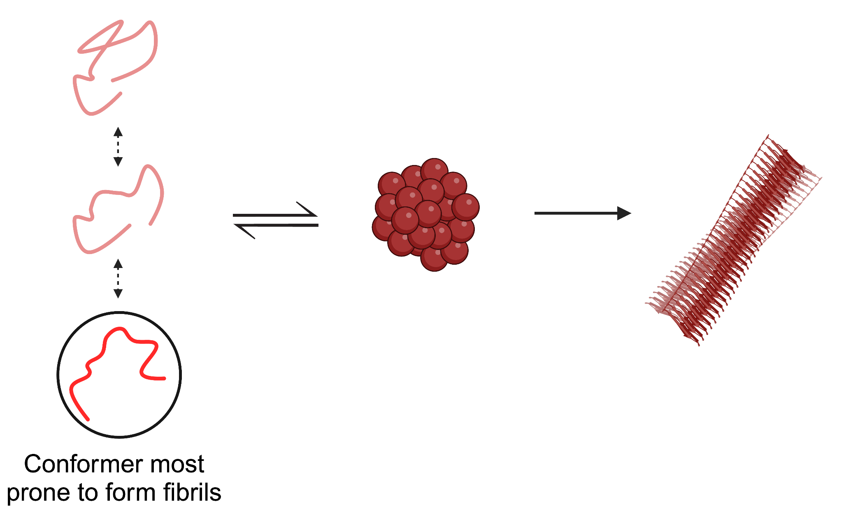
15th European Biophysics Congress
30th June– 4th July 2025, Rome
The native-state dynamics of α-Synuclein plays a crucial role
in determining its aggregation kinetics
Benedetta Fongaro^{1,2}, Philipp Trolese^{2,3}, Vittoria Scapin², Alice Sosic²,
Laura Acquasaliente² and Patrizia Polverino de Laureto²
¹Department of Agronomy Food Natural Resources Animals and Environment, University of Padova, Italy
²Department of Pharmaceutical and Pharmacological Sciences, University of Padova, Italy
³ Department of Neuroscience, Biomedicine and Movement Sciences, University of Verona, Italy
α-Synuclein (Syn) assembly into fibrils plays a central role in the pathogenesis of Parkinson disease. Recent studies have highlighted the impact of genetic mutations (H50Q and A53T) on Syn structure and its aggregation propensity. Syn populates an ensemble of conformations ensuing from its rugged folding energy landscape. Protein intramolecular interactions continuously open and close leading to forms that trigger aggregation. However, the influence of the native conformer distribution of mutants on Syn aggregation rate remains unclear. This study aims to investigate the correlation between dynamics properties in the native state of Syn and its familiar variants and their aggregation propensity. The analyses were performed using Native Mass Spectrometry (Native-MS), Size Exclusion Chromatography (SEC), Thioflavin-T assay (ThT) and Circular Dichroism (CD). Our results showed that in the native state the A53T mutation, which induces a destabilized and relaxed monomeric state, leads to a significantly faster aggregation rate. Differently, the H50Q mutant, which retains a compact conformation, exhibits a slower aggregation process. These findings provide important insights into the role of protein native conformation on its aggregation propensity. This understanding is crucial for developing targeted therapies that specifically address the structural factors driving aggregation.
AGGREGATION KINETICS
CONFORMATION
A
B
A53T>Syn>H50Q
C
Circular dichroism (CD) analysis of Syn and its pathological mutants (A). All the proteins are natively disordered (black line) and aggregate forming β-sheet structure after 72 h (red line) and more pronounced after 168 h (blue line). Consistently, Thioflavin-T (ThT) assay of Syn and its pathological mutants (B) indicates amyloid fibril formation after 168-h incubation.
Depending on the location and the specific point mutation differences in the aggregation rate can be detected. H50Q resulted to have a slow aggregation rate compared to Syn and A53T mutant. On the contrary, A53T protein starts its aggregation process immediately, reaching the plateau of the aggregation pathway just after 72 h of incubation.
Size exclusion chromatography (SEC) of Syn and mutated proteins (C). Differences in elution volume were revealed. H50Q mutant exhibits a longer elution volume, suggesting a more compact conformation compared to Syn. In contrast, the A53T showed shorter elution volume, which may indicate a less compact conformation than Syn. These results reflect differences in the protein compactness in their native state.
DYNAMICS PROBED BY NATIVE-MS
D
E
Native ESI-MS analysis (D). Three populations, indicated as 1, 2 and 3, seem to coexist under native conditions. They correspond to conformers with different compactness (E). Indeed, the extent of multiple charging is dependent upon the solvent-exposed area of the ions, thereby influencing the charge-state distributions. Conformers with a more compact structure appear in the higher m/z region of the spectra. Conversely, partially or fully unfolded protein molecules can accommodate a greater number of charges due to their increased surface area.
Specific point mutations resulted in alterations to the overall distribution of the protein conformers in solution, in comparison to Syn, affecting both structural flexibility and compactness (F). Population 2, with intermediate compactness properties, represents the most prevalent conformation for all the proteins, with different percentages. A53T shows preference for population 1, the less compact conformation, and resulted the protein with the higher exposed surface. H50Q populated a more compact conformation (3) compared with the other proteins.
F
CONCLUSIONS
The presence of specific point mutations led to differences in the aggregation kinetics of Syn. CD and ThT analyses showed that H50Q variant exhibits a slower aggregation rate compared to both Syn and A53T. A53T initiates aggregation immediately, reaching the plateau phase within 72 hours of incubation.
SEC analysis of Syn and its mutants revealed distinct elution volumes, indicating differences in the packing of these proteins in solution. The H50Q mutant exhibited a higher elution volume, suggesting a more compact conformation compared to Syn. In contrast, the A53T variant displayed lower elution volume, indicative of a less compact structural arrangement.
Notably, A53T exhibited the highest solvent-exposed surface, making it the most structurally relaxed variant compared to the wild type and other mutants. In contrast, H50Q adopted a more compact conformation than the other proteins.
Globally, the preferred native conformation of a protein seems to dictate its aggregation rate: less compact conformations lead to faster aggregation. Translating in vivo this means early onset of Parkinson disease.
Native-MS is an invaluable tool for studying protein dynamics, particularly the native conformations and aggregation of Syn and helped us to better comprehend protein aggregation and its implications in neurodegenerative diseases.

