Slide 1



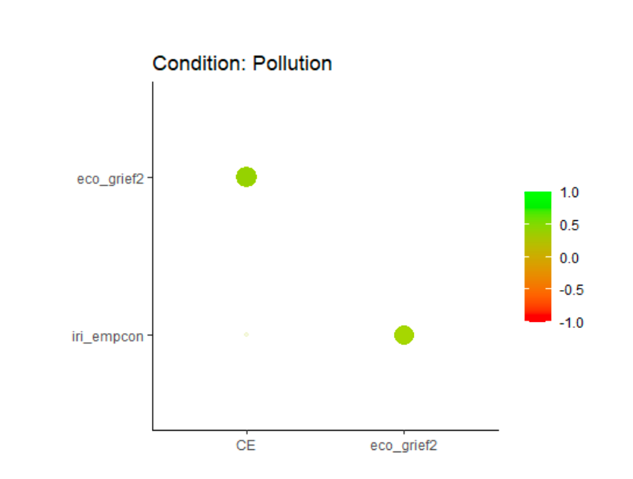
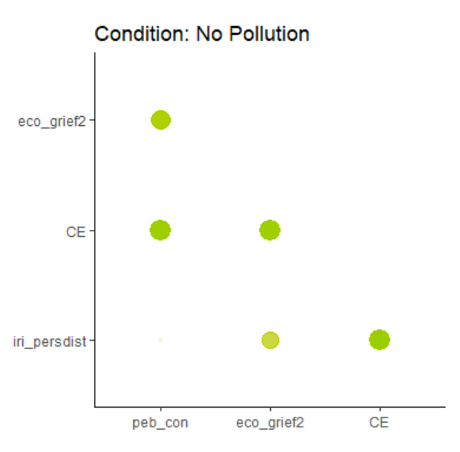
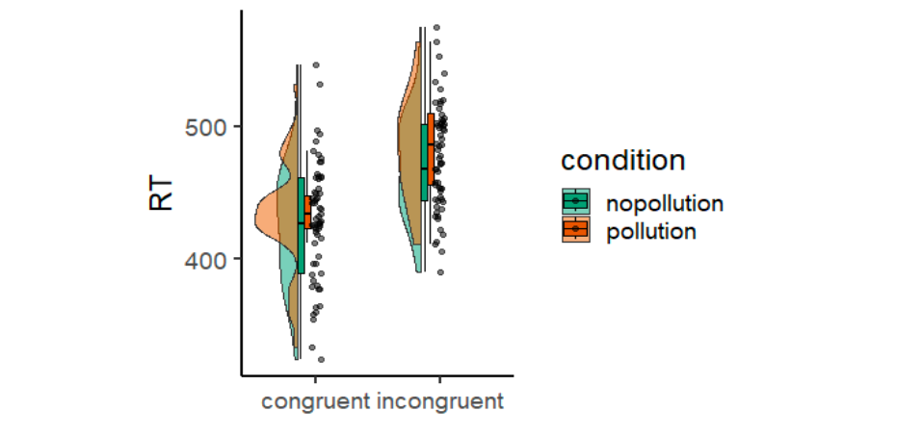
68-Emotions & Social Cognition#11
Implicit Error Monitoring and Perceived Eco-Anxiety:
The Relationship Between Environmental Dimension and Personal Variables
Vlad A L, Berardo G, Scandola M
annalaura.vlad@univr.it
Department of human sciences, University of Verona
ECO-EMOTIONS
GOALS
THEORETICAL FRAMEWORK
HYPOTHESIS
Climate change affects mental health. Eco-anxiety, Eco-guilt and Eco-grief represent a complex emotional response linked to the perception of environmental threats.
This study aims to explore the relationship between eco-emotions, environmental responsibility, and implicit cognitive processes related to conflict monitoring.
Eco-emotions influence decision-making and behavioral processes. Conflict monitoring, mediated by ACC activity, enables the regulation of discrepancies between automatic responses and expected behaviors.
The environmental responsibility condition will influence conflict monitoring, leading to measurable differences in the ability to regulate discrepancies between automatic responses and expected behaviors.
How do perceived environmental responsibility and eco-emotions (eco-anxiety, eco-guilt, eco-grief) influence implicit conflict monitoring in cognitive tasks?
SAMPLE DESCTIPTION
MATERIALS
32 participants
Sex: 15 males, 17 females
Age: 18–40 years
Females: M = 23.88, SD = 4.94
Males: M = 23.80, SD = 2.73
Education: high school diploma or higher
Exclusion criteria: certified diagnoses of learning disorders
Participation: voluntary and unpaid
EGuiQ-11
EGriQ-6
EAQ-22
OC–AN Scale
HADS
IRI
BIS-11
BIS/BAS Scale
GEB-26
PEBS
Single Category IAT
Pollution-Distancing Task
Eco-Flanker Task
EXPERIMENTAL PROCEDURE
STATISTICAL ANALYSES
The sessions were conducted in person, in a controlled and distraction-free environment, and participants were tested individually at different times.
The order of administration of the instruments was randomized using a Latin square design (4×4), employing multiple versions of some tasks to counterbalance the experimental conditions.
The overall session duration was 65–80 minutes.
Data were prepared for analysis using OpenSesame software.
Analysis of questionnaire scores, reaction times, and behavioral indices
Computation of the Congruency Effect (CE = incongruent RT − congruent RT)
Analysis of RTs as a function of condition, congruency, and distance
Descriptive statistics and exploratory factor analyses
Post-hoc contrasts and Pearson correlations with psychological variables
RESULTS
Experimental condition: Reaction times were significantly slower in the pollution condition compared to the no-pollution condition (F = 15.02, p < .001; Δ = 11.3 ms; 458 ms vs. 447 ms).
Congruency: Reaction times were significantly slower on incongruent trials compared to congruent trials (F = 289.58, p < .001; Δ = 49.5 ms; 477 ms vs. 428 ms).
In the Pollution condition, the Congruency Effect showed the highest correlation with ecological grief (r = .42).
A positive association also emerged between CE and empathy (r = .32).
In the No Pollution condition, the Congruency Effect showed a positive correlation with consumption-related pro-environmental behaviours (r = .38).
A significant correlation emerged with personal distress (r = .39).
A positive correlation was observed with ecological grief (r = .38).
Findings suggest that exposure to pollution-related stimuli leads to slower reaction times, indicating increased cognitive load in environmentally threatening contexts. As expected, participants responded more slowly to incongruent than congruent trials, confirming the classic Flanker congruency effect reported in previous research. In the pollution condition, greater difficulties in conflict monitoring were associated with higher levelsof ecological grief and empathy, suggesting that individuals who feel more emotional involvement or concern about environmental issues may be more cognitively affected by pollution contexts. In the no-pollution condition, conflict monitoring difficulties were linked to consumption-related, pro-environmental behaviours, personal distress, and ecological grief, indicating that both emotional vulnerability and eco-related concerns can impact cognitive control even in neutral environmental contexts.
BIBLIOGTAPHY
-Ágoston, C., Urban, R., Nagy, B., Csaba, B., Kőváry, Z., & Kovacs, K. (2022). The psychological
consequences of the ecological crisis: Three new questionnaires to assess eco-anxiety, eco-guilt,
and ecological grief. Climate risk management, 37, 100441.
-Donkers, F. C., & van Boxtel, G. J. (2004). The N2 in go/no-go tasks reflects conflict monitoring not response inhibition. Brain and Cognition , 165-176.
-Ridderinkhof, K., Wylie, S., van den Wildenberg, W. P., W., Bashore, T., & van der Molen , M. (2021).
The arrow of time: Advancing insights into action control from the arrow version of the Eriksen
flanker task. Attention, Perception, & Psychophysics, 83, 700-721
-Ágoston, C., Urban, R., Nagy, B., Csaba, B., Kőváry, Z., & Kovacs, K. (2022). The psychological
consequences of the ecological crisis: Three new questionnaires to assess eco-anxiety, eco-guilt,
and ecological grief. Climate risk management, 37, 100441.
-Donkers, F. C., & van Boxtel, G. J. (2004). The N2 in go/no-go tasks reflects conflict monitoring not response inhibition. Brain and Cognition , 165-176.
-Ridderinkhof, K., Wylie, S., van den Wildenberg, W. P., W., Bashore, T., & van der Molen , M. (2021).
The arrow of time: Advancing insights into action control from the arrow version of the Eriksen
flanker task. Attention, Perception, & Psychophysics, 83, 700-721

