Slide 1



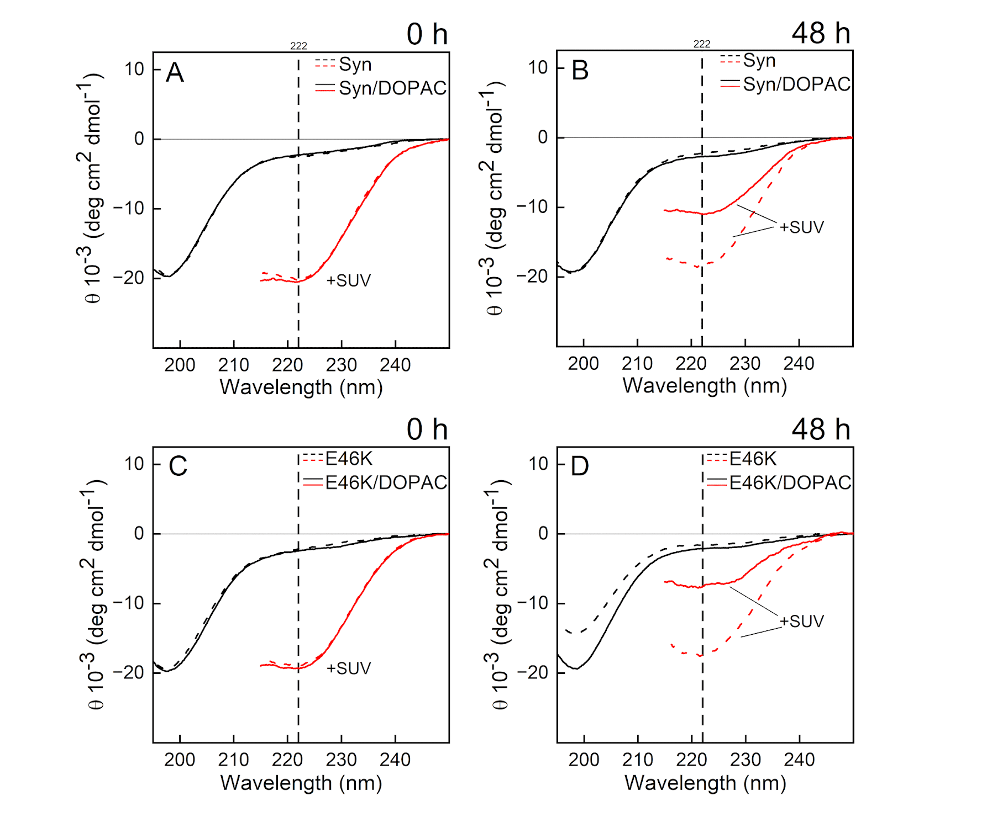
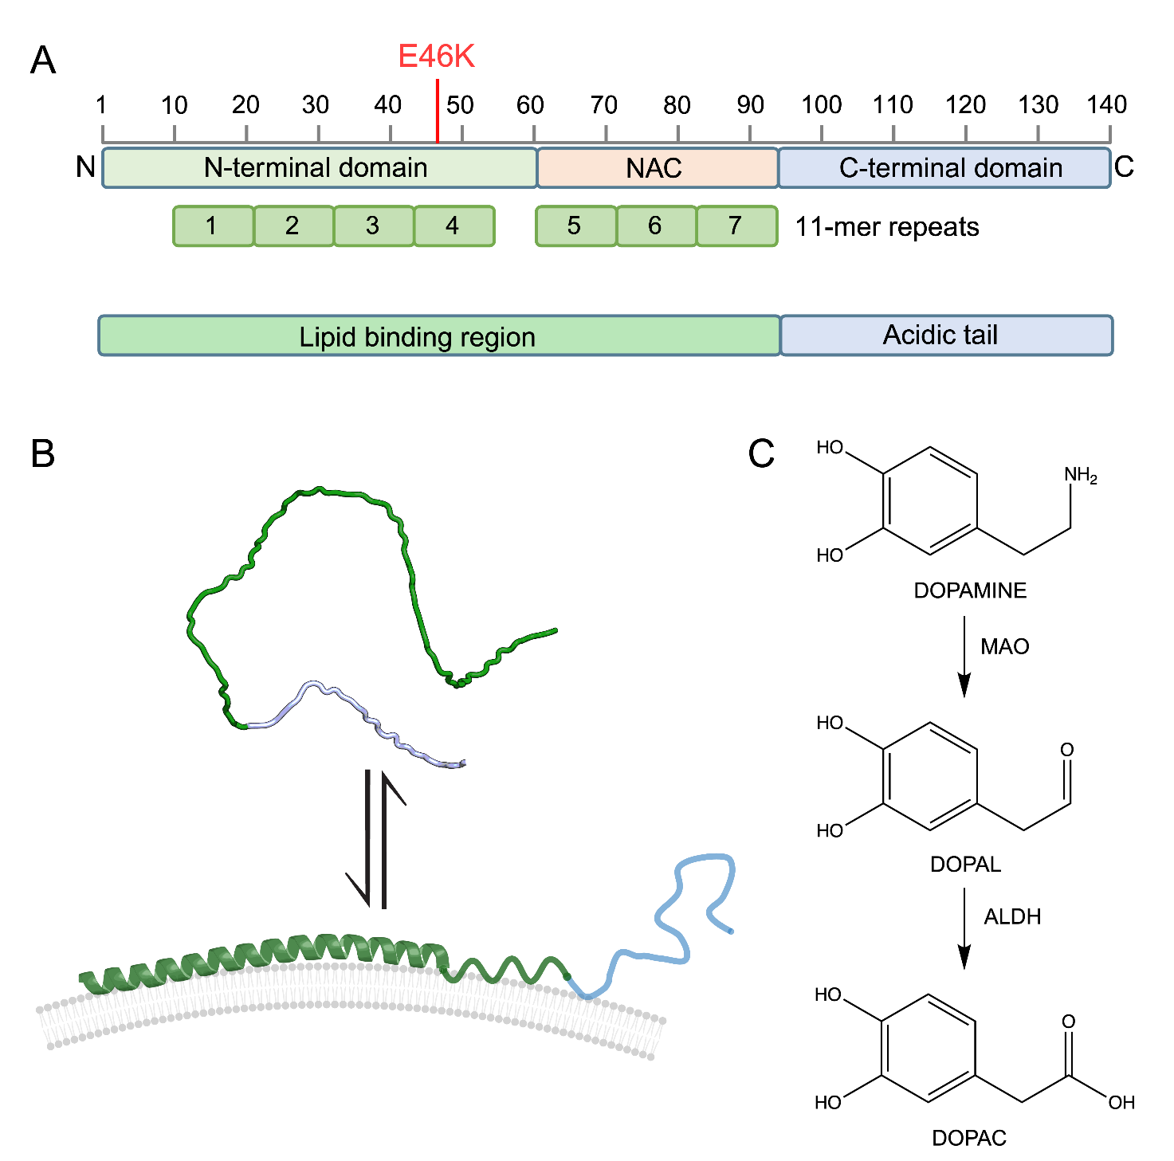
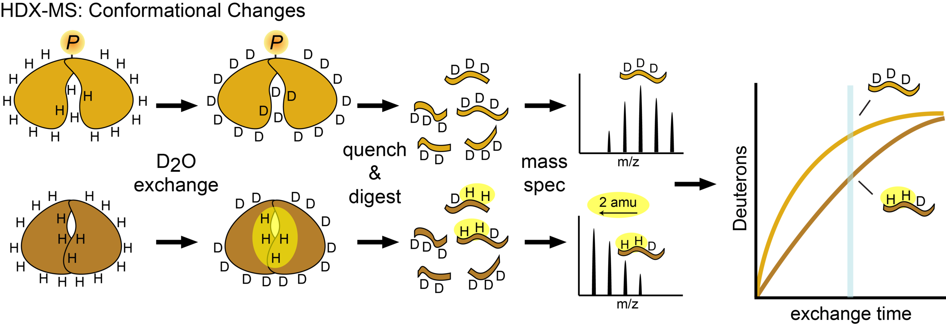
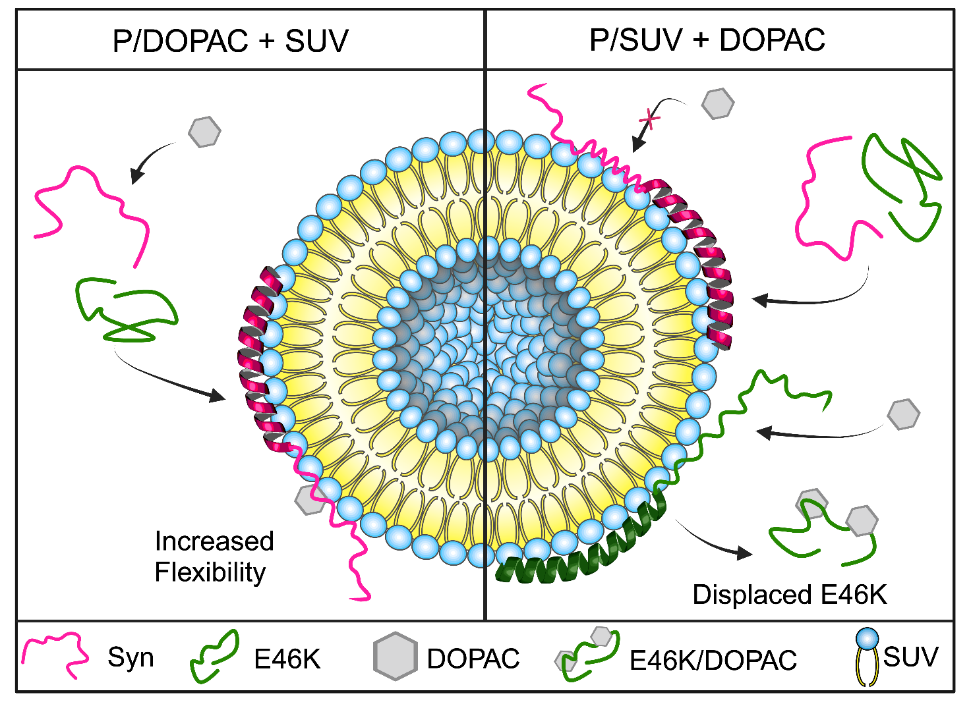

30 June – 4 July 2025
ROME – Italy
Biophysical analysis of DOPAC-induced alterations in
⍺-Synuclein and E46K membrane binding dynamics
Philipp Trolese^{1,2}, Benedetta Fongaro¹, Laura Acquasaliente¹, Patrizia Polverino De Laureto¹
¹Department of Pharmaceutical and Pharmacological Sciences, University of Padova, Padova, Italy
²Section of Biochemistry, Department of Neuroscience, Biomedicine and Movement Sciences, University of Verona, Verona, Italy
Introduction
Results
α-Synuclein (Syn) is an intrinsically disordered protein, highly abundant in presynaptic neurons, where it is involved in synaptic vesicle trafficking and turnover. It populates an ensemble of conformations in vivo and it floats in equilibrium between the free random coil and the membrane-bound α-helical structure. Syn was found in the Lewis Body inclusions in the form of amyloid fibrils, present in the brain of patients suffering from Parkinson Disease. E46K is a pathogenic genetic mutant of Syn. The mutation accelerates the formation of fibrils. Moreover, the presence of a lysine residue in position 46 affects several structural properties of the mutant including its interaction with the membranes, and particularly the rate of association-dissociation on lipid surfaces.
Recently, we have shown that 3,4-dihydroxyphenylacetic acid (DOPAC), a dopamine metabolite, not only hampers Syn to form fibrils, interfering with the protein aggregation process, but also alters the ability of the protein and its aggregates to interact with cell membranes^{1,2}. Here, to understand the mechanism of such alteration, we studied the interaction of Syn and E46K with biological membranes in the presence of DOPAC³.
a) P/DOPAC + SUV
Figure 1.
Far-UV CD analysis of Syn and E46K interactions with SUVs. (A, C) show spectra of Syn and E46K pre-incubated with DOPAC (P/DOPAC) at time 0; (B, D) show spectra after 48 h incubation (P/DOPAC + 48 h). SUV concentration was chosen to ensure minimal unbound protein.
Lines indicate:
Solid black – protein + DOPAC
Dashed black – protein alone
Solid red – protein + DOPAC + SUV
Dashed red – protein + SUV
Figure 2.
HDX-MS analysis of Syn and E46K interactions with SUVs in the presence of DOPAC. All profiles were recorded after 10 minutes of deuterium exchange.
(A) Deuteration of Syn (red) and E46K (black) in complex with SUVs (P/SUV).
(B) Comparison: Syn/SUV (red) vs. Syn/DOPAC + SUV (purple).
(C) Comparison: E46K/SUV (black) vs. E46K/DOPAC + SUV (light blue).
(D) Overlay showing the DOPAC-induced changes in E46K deuteration (from C), added to (B) for direct comparison.
b) P/SUV + DOPAC
Methods
Two systems were studied:
a) P/DOPAC + SUV
Here, the protein was first incubated with DOPAC and only successively small unilammelar vesicles (SUVs) were added.
b) P/SUV + DOPAC
Here, DOPAC was added on the already formed protein liposome complex.
Diverse conformational and dynamic changes resulting from the interactions caused by the altered order of addition were studied by hydrogen deuterium exchange mass spectrometry (HDX-MS) and circular dichroism (CD).
Schematic Diagram of HDX-MS to probe conformational changes⁴
Figure 3.
Far-UV CD analysis of Syn and E46K interactions with SUVs in the presence or absence of DOPAC. (A, C) show spectra at time 0; (B, D) show spectra after 48 h incubation without shaking. SUV concentration was set to ensure negligible unbound protein. DOPAC was added at a 1:5 protein/DOPAC molar ratio.
Dashed red lines – protein + SUV
Solid red lines– protein + DOPAC + SUV
Dashed black lines – protein alone
Solid black lines– protein + DOPAC
Figure 4.
HDX-MS analysis of DOPAC’s effect on Syn and E46K interactions with SUVs. All profiles were recorded after 10 minutes of deuterium exchange.
(A) Syn/SUV (red) vs. Syn/SUV + DOPAC (pink)
(B) E46K/SUV (black) vs. E46K/SUV + DOPAC (green)
(C) Comparison of DOPAC-induced deuteration changes in Syn (pink) and E46K (green) bound to SUVs
References
Conclusions
Palazzi, L.; Fongaro, B.; Leri, M.; Acquasaliente, L.; Stefani, M.; Bucciantini, M.; Polverino de Laureto, P. Structural Features and Toxicity of α-Synuclein Oligomers Grown in the Presence of DOPAC. International Journal of Molecular Sciences 2021, 22 (11), 6008.
Fongaro, B.; Cappelletto, E.; Sosic, A.; Spolaore, B.; Polverino de Laureto, P. 3,4-Dihydroxyphenylethanol and 3,4-Dihydroxyphenylacetic Acid Affect the Aggregation Process of E46K Variant of α-Synuclein at Different Extent: Insights into the Interplay between Protein Dynamics and Catechol Effect. Protein Science 2022, 31 (7), e4356.
Rizzotto, E.; Pierangelini, A.; Fongaro, B.; Leri, M.; Inciardi, I.; Trolese, P.; De Filippis, V.; Bucciantini, M.; Acquasaliente, L.; Polverino de Laureto, P. DOPAC as a Modulator of α-Synuclein and E46K Interactions with Membrane: Insights into Binding Dynamics. International Journal of Biological Macromolecules 2025, 294, 139427.
https://www.underbakkelab.org/techniques
Syn/DOPAC shows increased H/D exchange in the 55–70 region, whereas E46K/DOPAC remains unaffected when complexed with SUVs.
E46K/SUV is partially displaced by DOPAC, while no interaction with Syn/SUV is observed, suggesting the latter is tighter bound.
These findings suggest that DOPAC modulates Syn-membrane interactions while preferentially affecting the membrane-bound E46K species, enhancing their structural dynamics.
Let’s connect!

